Slide 1
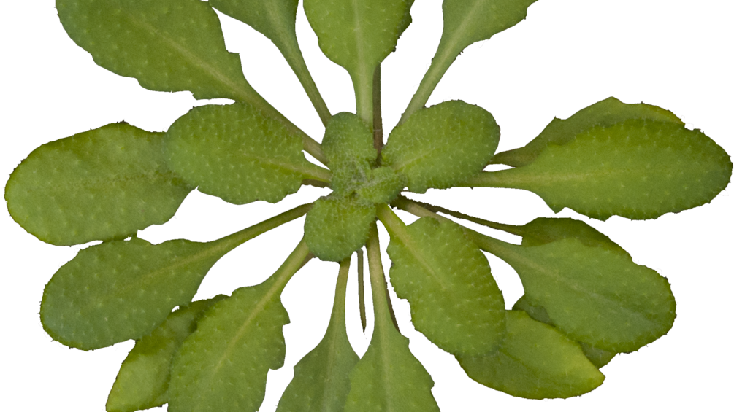
Identification and Analysis of LEA-3 Protein Motifs
Ralph Arvin De Castro
BIOM*4521 |Supervisor: Steffen Graether
Notes:
Hi, everyone, my name is Ralph and my research topic is about the identification and analysis of LEA-3 protein motifs

Slide 2
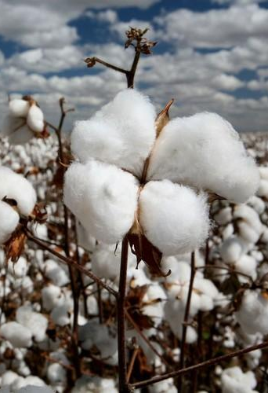
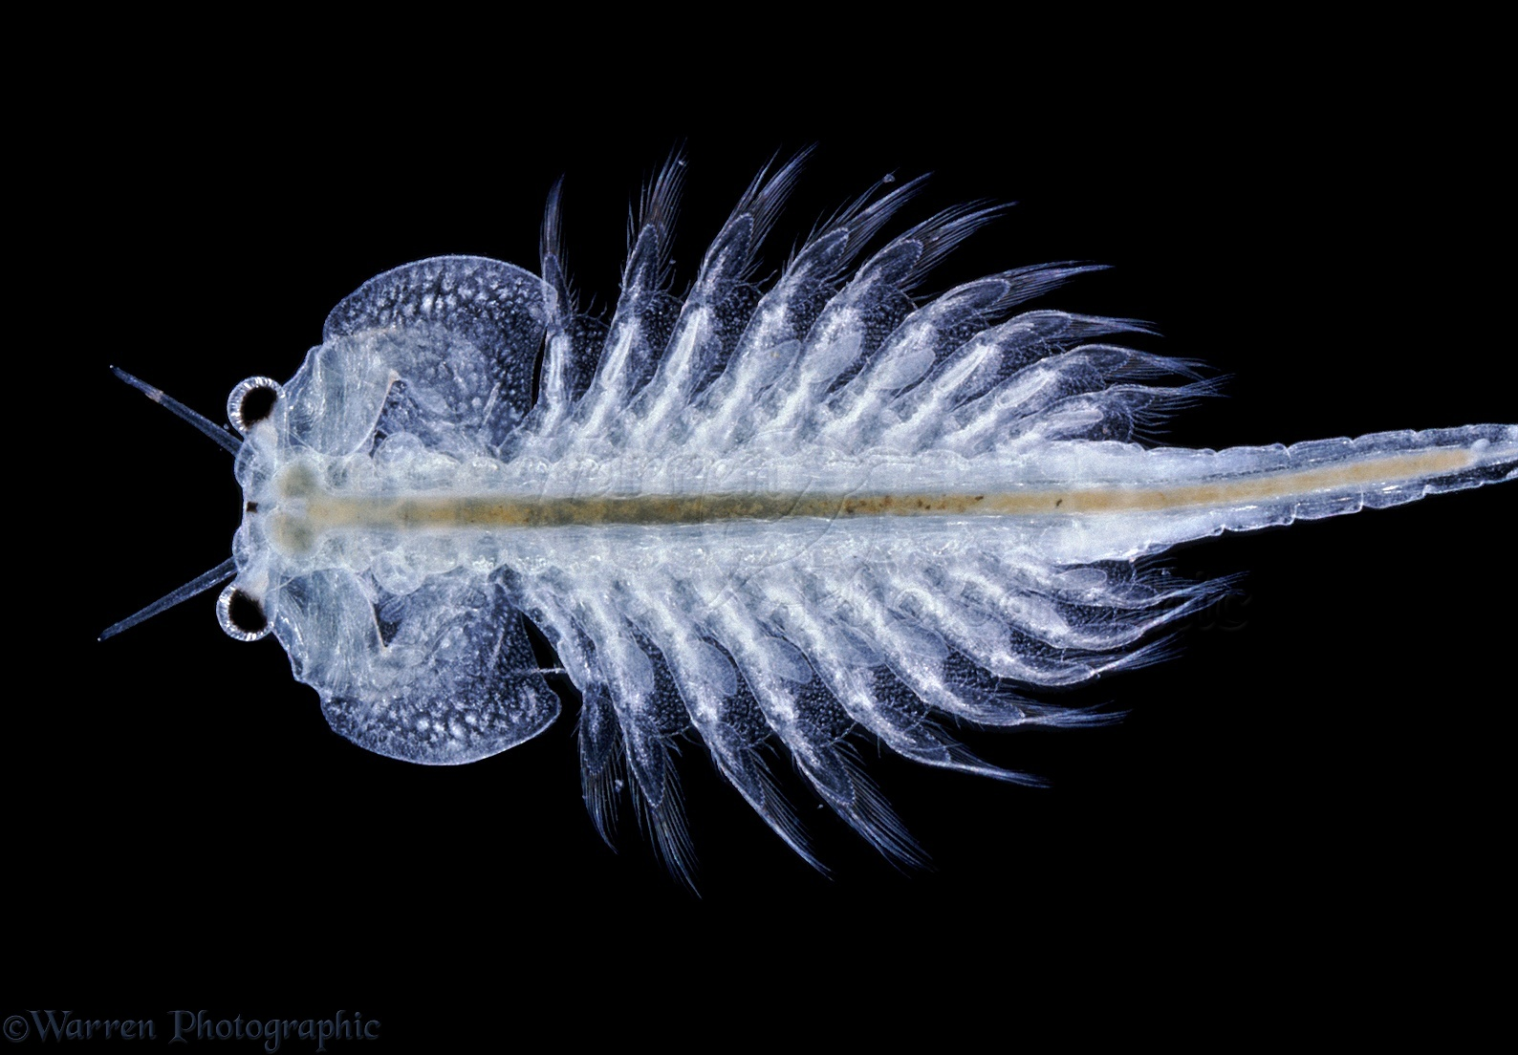
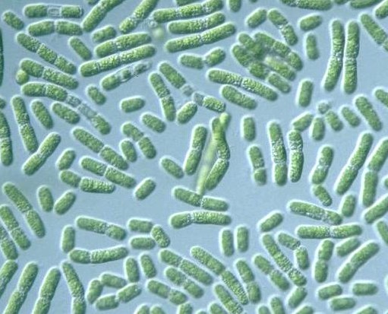
Introduction
What are LEA Proteins?
Late Embryogenesis Abundant proteins
Large group of proteins that accumulate in the late embryogenesis of seeds
First found in cotton seeds
Not plant specific: LEA-like proteins also found in non-plant species
Brine Shrimp
Cotton
Cyanobacteria
Notes:
The main focus of my research is about these lea proteins
So LEA proteins is just a short form of the term late embryogenesis abundant protein
And as you can tell from the term, they are proteins that accumulate or become abundant in the late stage of embryogenesis of seeds
They were first discovered in cottons but also later found that they do not only occur in plants because they were also detected in other species such as brine shrimp and cyanobacteria
L

Slide 3
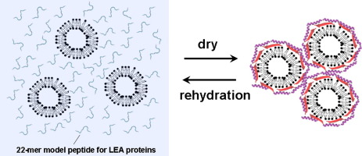
LEA Protein Function
Function in desiccation tolerance
LEA Proteins have been associated with cellular resistance to dehydration
Protect other proteins from aggregation during abiotic stresses (freezing, drying and saline conditions)
Mechanism about this structure-function relationship is still unclear
Furuki et.al (2014)
Notes:
So what do lea proteins do?
These proteins has the function desiccation tolerance which means that lea proteins help tolerance to dehydration. They do this by protecting other proteins from aggregating with each other as you can see in this picture
However, the mechanism about this is still unclear.

Slide 4
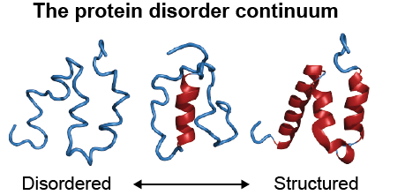
LEA Protein Structure
Hydrophilic – low hydrophobicity
Disordered - belongs to the structural group called intrinsically disordered proteins (IDP).
do not have a defined structure
can gain structure when a ligand is bound.
Weis (2011)
Notes:
In terms of structure, lea proteins are hydrophilic
Morever, they are also disordered as they belong to the structural group called intrinsically disordered protein or IDPs in short.
These proteins do not have a defined structure as you can see from the image.
However, they can gain structure when a ligand binds which suggests that these proteins can have a functional role

Slide 5
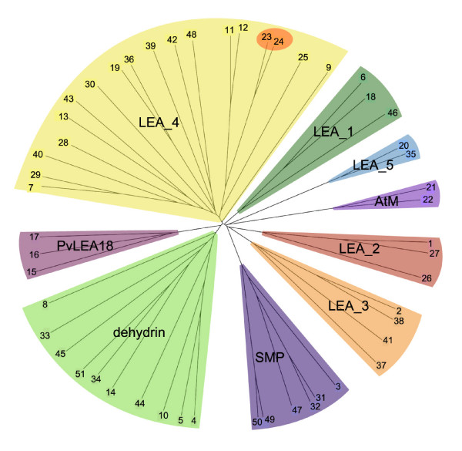
LEA Protein Subgroups
LEA proteins have been grouped into various families on by sequence similarity
In Arabidopsis thaliana, there are 9 sub-groups of LEA protein
Hundertmark et.al (2008)

Slide 6
LEA Protein Subgroups
LEA proteins have been grouped into various families on by sequence similarity
In Arabidopsis thaliana, there are 9 sub-groups of LEA protein
Focus subgroup:
LEA-3 proteins
Hundertmark et.al (2008)

Slide 7
LEA Protein Subgroups
Why LEA-3 Proteins?
Under-researched compared to dehydrins (another subgroup)
No novel function for abiotic stress defined
LEA proteins have been grouped into various families on by sequence similarity
In Arabidopsis thaliana, there are 9 sub-groups of LEA protein
Focus subgroup:
LEA-3 proteins
Hundertmark et.al (2008)

Slide 8
Protein Sequence Motifs
Conserved
regions
Regions that are not conserved
IDP (ex. LEA-3 protein)
Notes:
SO this IDPs can have regions that are conserved and regions that are not conserved. And this conserved regions may have a functional role. This conserved regions that have a functional role can be called sequence motifs.
Sequence motifs are sequences that occur repeatedly in the protein family and these sequence can be used to predict the function of the protein

Slide 9
Protein Sequence Motifs
May have a functional role
Conserved
regions
Regions that are not conserved
IDP (ex. LEA-3 protein)
Notes:
SO this IDPs can have regions that are conserved and regions that are not conserved. And this conserved regions may have a functional role. This conserved regions that have a functional role can be called sequence motifs.
Sequence motifs are sequences that occur repeatedly in the protein family and these sequence can be used to predict the function of the protein

Slide 10
Protein Sequence Motifs
May have a functional role
Conserved
regions
Regions that are not conserved
Sequence motifs
Sequence that occurs repeatedly in a protein family
Can be used to predict the function of the protein
IDP (ex. LEA-3 protein)
Notes:
SO this IDPs can have regions that are conserved and regions that are not conserved. And this conserved regions may have a functional role. This conserved regions that have a functional role can be called sequence motifs.
Sequence motifs are sequences that occur repeatedly in the protein family and these sequence can be used to predict the function of the protein

Slide 11
OBJECTIVE
Determine sequence motifs for LEA-3 proteins and discover its function in desiccation tolerance
HYPOTHESIS
If the LEA-3 proteins are determined and indicate a novel function, then the mechanism behind its role in abiotic stress can be implied.
Notes:
And for my research project, I want to focus on the LEA-3 protein subgroup
And therefore my objective is to determine the sequence motif of LEA-3 proteins
My hypothesis is
If LEA-3 protein novel motifs are determined, then mechanism behind its role in dehydration tolerance can be implied.
If LEA-3 protein novel motifs are determined, then the

Slide 12
Methodology
Protein Sequences
Selection
Motif Discovery and Analysis
Notes:
There are two main steps to my methodology.
The first is the selection of protein sequences and second is motif discovery and analysis

Slide 13
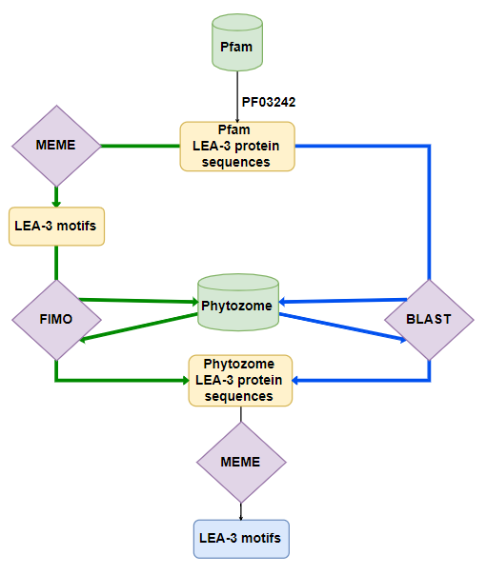
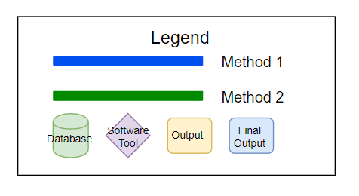
1. Protein Sequences Selection
Gathering of potential LEA-3 protein sequences from a database using bioinformatic search tools
Notes:
So firstly, we want to select our protein sequences.
As you can see in this diagram, we want to gather protein sequences that are potentially LEA-3.
And we can get them by using search tools.

Slide 14


Databases
Protein family database
490 LEA-3 proteins
Plant Genome database
~2,000,000 protein sequences
Notes:
The databases I used are Pfam and Phytozome
Pfam is protein family database and I used it to get the true LEA-3 sequences
And I also utilized phytozome which is a plant genome resource and in this database, we can get our LEA-3 sequences for finding motifs

Slide 15
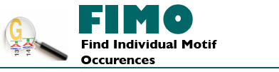

Search Tools/Programs
Both scan a set of sequences (Phytozome) and search for matching proteins using a query sequence (Pfam)
Notes:
In this research, I used two search programs which are called FIMO and BLASY
They both scan a set of sequences and search for matching proteins

Slide 16
2. Motif Discovery and Analysis
Generation of potential motifs from gathered protein sequences using a motif discovery tool
Notes:
So now that we have our lea-3 sequences, we can now generate our motif using a motif discovery tool

Slide 17

Motif Discovery Tool
Discovers novel, ungapped motifs from a set of sequences (Ex. LEA-3 sequences)
Notes:
And the tool that I used is meme
And it discover novel, ungapped motifs in a set of sequences
In our case, our lea-3 sequences

Slide 18

Motif Discovery Tool
Discovers novel, ungapped motifs from a set of sequences (Ex. LEA-3 sequences)
Notes:
And the tool that I used is meme
And it discover novel, ungapped motifs in a set of sequences
In our case, our lea-3 sequences

Slide 19
Motif Discovery Tool
Discovers novel, ungapped motifs from a set of sequences (Ex. LEA-3 sequences)
Notes:
And the tool that I used is meme
And it discover novel, ungapped motifs in a set of sequences
In our case, our lea-3 sequences

Slide 20
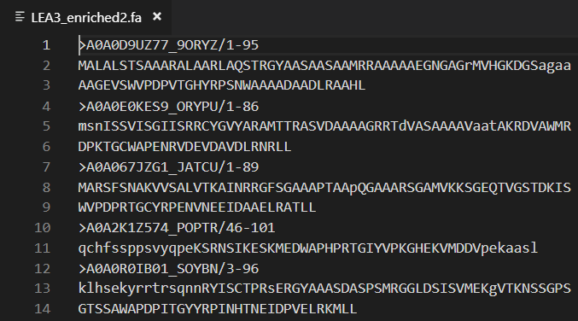
Results
After blasting (E-value of 1e-6) Pfam sequences against Phytozome sequences
We gathered 889 potential LEA-3 protein sequences

Slide 21
Results
889 protein sequences
4 motifs

Slide 22
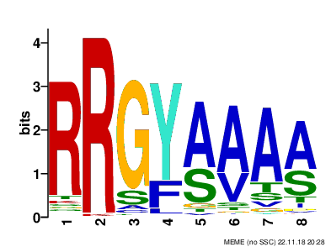
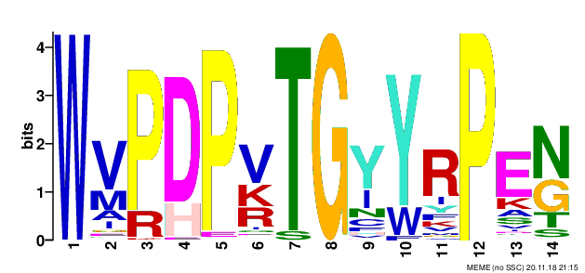
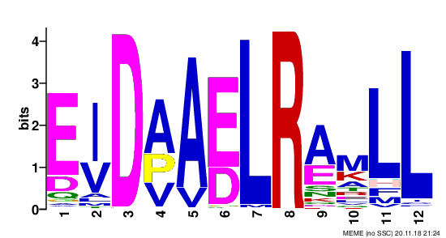
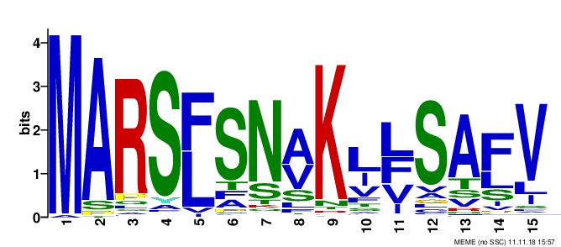

Slide 23
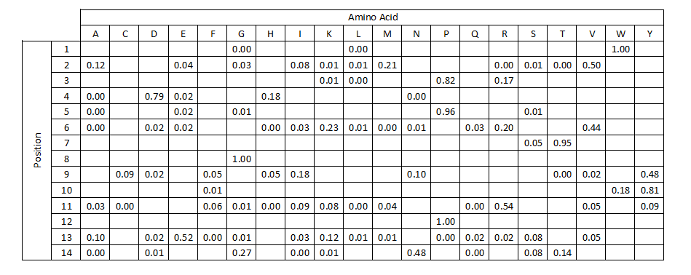
Motif 1
W-motif

Slide 24
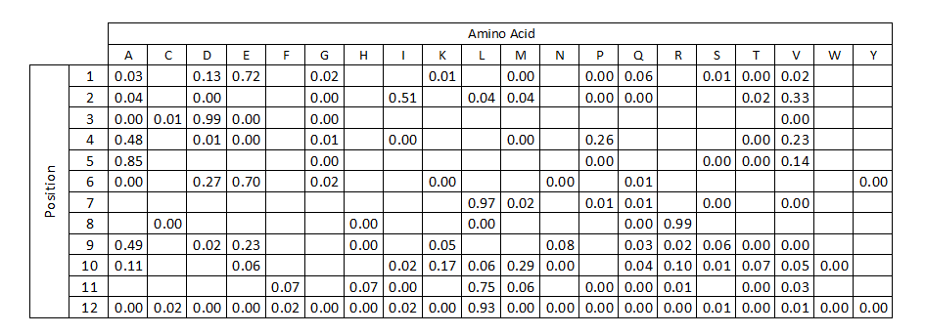
Motif 2
LL-motif
LL-motif

Slide 25
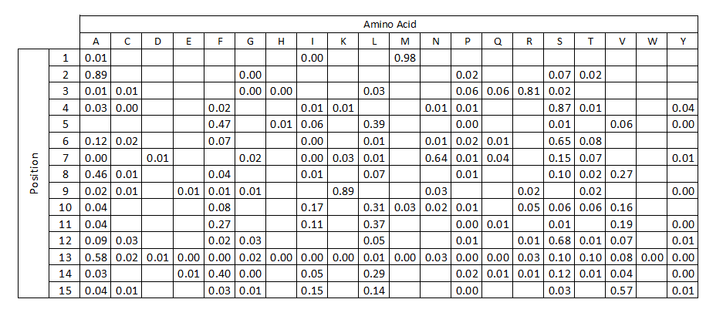
Motif 3
RA-motif
A- motif

Slide 26
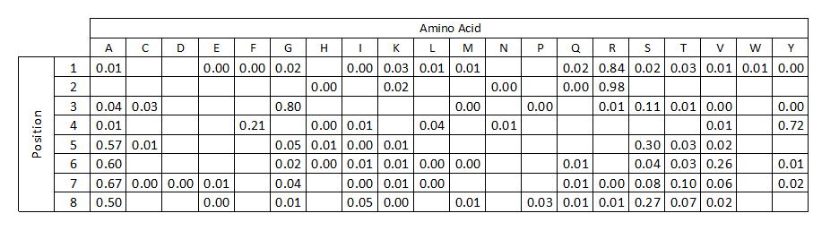
Motif 4
MARS-motif

Slide 27
Discussion of Results
Motif | E-Value | Sites | Width
 | 1.3e-8373 | 871 | 14
 | 7.5e-3738 | 574 | 12
 | 1.7e-1324 | 544 | 8
 | 3.9e-1818 | 290 | 15

Slide 28
Position of motifs
N
C

Slide 29
Summary/Plans for next semester
We proposed 4 potential LEA-3 protein motifs
W-motif is the most conserved motif and the most defining feature of LEA-3 proteins, which can imply an important function.
Future semester plans
Functional Analysis of these motifs (isoelectric point, hydrophobicity, molecular mass, fold index)
Notes:
More conserved – function (important function)

Slide 30
References
Malik, A. A., Veltri, M., Boddington, K. F., Singh, K. K., & Graether, S. P. (2017). Genome Analysis of Conserved Dehydrin Motifs in Vascular Plants. Frontiers in plant science, 8, 709. doi:10.3389/fpls.2017.00709
Furuki T, Sakurai M. Group 3 LEA protein model peptides protect liposomes during desiccation. Biochimica et biophysica acta. 2014;1838(11):2757–66. Epub 2014/07/19. doi: 10.1016/j.bbamem.2014.07.009
Hundertmark, M., & Hincha, D. K. (2008). LEA (late embryogenesis abundant) proteins and their encoding genes in Arabidopsis thaliana. BMC genomics, 9, 118. doi:10.1186/1471-2164-9-118
Goyal K, Walton LJ, Tunnacliffe A. LEA proteins prevent protein aggregation due to water stress. Biochem J. 2005;388:151–157. doi: 10.1042/BJ20041931.

Slide 31
Questions?

